Slide 1

Community Service Project
On
Emergency Automobile Services
By
Under the guidance of
Mr.K.Bhaskar, M.Tech(Ph.D)
Assistant Professor, Department of Computer Science and Engineering.
K.Pardha Chandra Mouli Mani | 22481A0589
G.Denny Siva Sai Siddhu | 22481A0570
K.Mohan Raj Kumar | 22481A0595
G.Nithin Roy | 22481A0574

Slide 2

Emergency Automobile Service: A Web App Solution
When your vehicle breaks down on the road, getting timely assistance can be challenging, especially in remote areas. Our web app provides a seamless solution, connecting you with nearby service providers and tracking the status of your roadside assistance request.

Slide 3
Addressing the Need for Timely Assistance
Challenges of Vehicle Breakdowns
Benefits of a Web App Solution
Vehicle breakdowns can be stressful, especially in remote areas with limited access to help. Drivers often face long wait times, uncertainty, and the risk of further damage to their vehicles.
Our web app helps drivers quickly connect with nearby service providers, reducing wait times and providing real-time status updates to ease the stress of a breakdown.

Slide 4
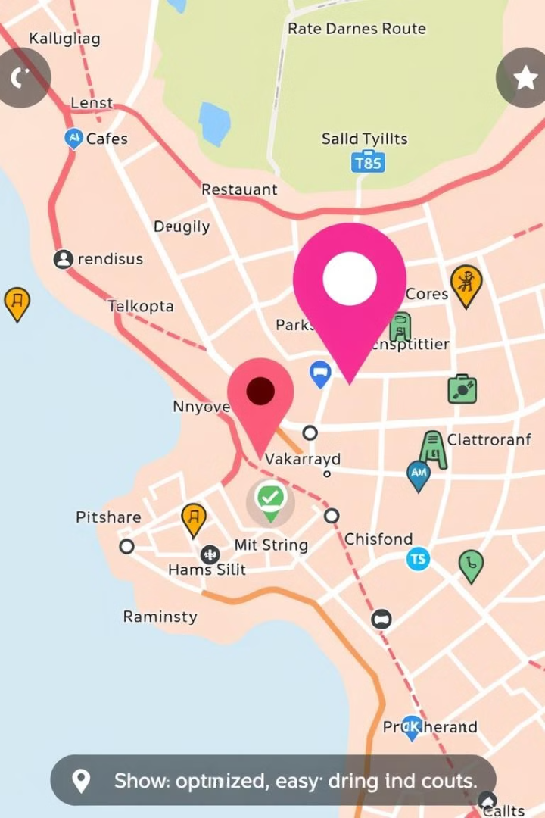
Leveraging Location-Based Services
1
Precise Location Tracking
2
Nearest Service Providers
The web app uses your device's GPS to pinpoint your exact location, ensuring a swift and accurate dispatch of roadside assistance.
The app automatically identifies the closest available service providers, such as tow trucks and mechanics, to expedite your assistance.
3
Route Optimization
The app can optimize the route for the service provider, minimizing their travel time and getting you back on the road faster.

Slide 5
Key Features of the Web Application
User Registration
Roadside Assistance Request
Drivers can securely register and store their vehicle and contact information for faster service requests.
Users can quickly submit a detailed service request with their location, issue, and preferred assistance options.
Service Provider Connection
Real-Time Tracking
Users can monitor the status of their service request and the estimated time of arrival for the provider.
The app matches the user's request with nearby service providers and facilitates the connection for prompt assistance.

Slide 6
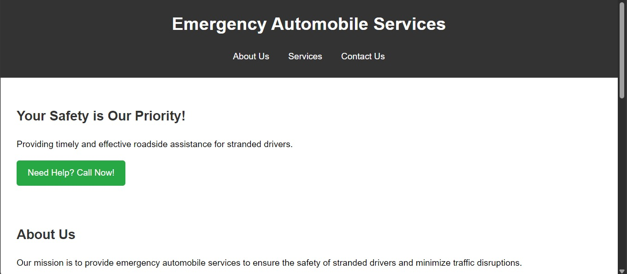

Slide 7
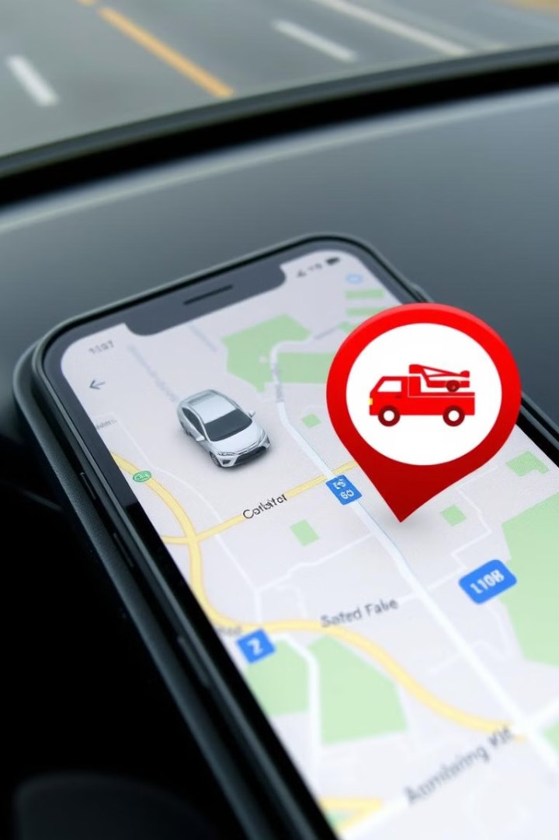
Locating Your Vehicle's Position Accurately
1
GPS Detection
The app utilizes your device's built-in GPS to pinpoint your exact location, providing real-time updates to the service providers.
2
Landmark Identification
The app can also identify nearby landmarks and cross-streets to further refine the location details, ensuring a swift response.
3
Live Tracking
Once the service provider is dispatched, the app allows you to track their progress, keeping you informed of their estimated time of arrival.

Slide 8
User Interface
Screenshots of the app interface (home screen, service request, payment).
Brief description of the user experience.
Emphasis on ease of use and accessibility.
Benefits
Convenience: Request help from anywhere, anytime.
Speed: Quick response times from service providers.
Safety: Enhanced safety for users in emergencies.
Cost-effective: Competitive pricing for services.

Slide 9
KEY TAKEAWAYS:
User -Centric Design: The layout is designed to prioritize user engagement, featuring a grid system that allows for easy browsing of service options. The use of service cards provides a clear and concise presentation of information.
Visual Appeal: The incorporation of a cohesive color scheme, responsive design, and interactive elements (like hover effects) contributes to an attractive aesthetic that can capture and retain user attention.
Responsiveness: The website is designed to be mobile-friendly, ensuring that users can access information on any device, whether it's a smartphone, tablet, or desktop. This adaptability is crucial in today’s digital landscape.
Content Management: The use of JavaScript to dynamically populate the service listings allows for easy updates and scalability. This feature means that as new services become available, they can be added without significant changes to the underlying code.
Future Enhancements: The website can be further enhanced with features such as user reviews, ratings, filtering options, and search functionality. These additions could significantly improve user engagement and satisfaction.
Community Connection: By showcasing nearby services, the website fosters a sense of community and encourages users to explore local businesses, ultimately supporting the local economy

Slide 10
Final Thoughts
In conclusion, the "Nearby Services" website serves as a valuable resource for users looking to connect with local offerings. With its focus on user experience, aesthetic appeal, and future scalability, the site is well-positioned to become a go-to platform for discovering nearby services. Continuous feedback from users can guide future improvements, ensuring that the website remains relevant and effective in meeting the needs of its audience.

Slide 11
THANK YOU

